Slide 1
Laparodome
Developer: BothPoints LLC
Description:
Laparoscopic Skill Monitoring app is a one stop shop for all your laparoscopic training needs. Compatible with the Laparodome training device, users can work on their laparoscopic surgical skills. With instructional prompts, task video recording, and self-evaluation checklists, this app provides a complete suite of training and support for laparoscopic surgical skills training.

Slide 2
Task Selection
Task 1: Peg Transfer
Task 2: Pattern Cut
Task 3: Ligating Loop
Task 4: Intracorporeal Suture
Task 5: Extracorporeal Suture

Slide 3
Task 1: Peg Transfer
Task Instructions:
Timing begins when first object is touched. Timing ends upon release of last object.
Pick up each object using grasper in non-dominant hand.
Transfer the object mid-air to dominant hand.
Place the object onto a peg on the opposite peg side of the pegboard, switching patterns. There is no importance for color or order of transfer.
Repeat until all objects have been transferred to opposite side of the board.
When all 6 objects have been moved, reverse the process, starting with dominant hand and transferring to non-dominant hand.
Penalties:
Maximum time: 300 secs
Time limit for proficiency: 48 secs
Dropping an object outside the field of view
Instrument leaving the field of view
Begin Task

Slide 4
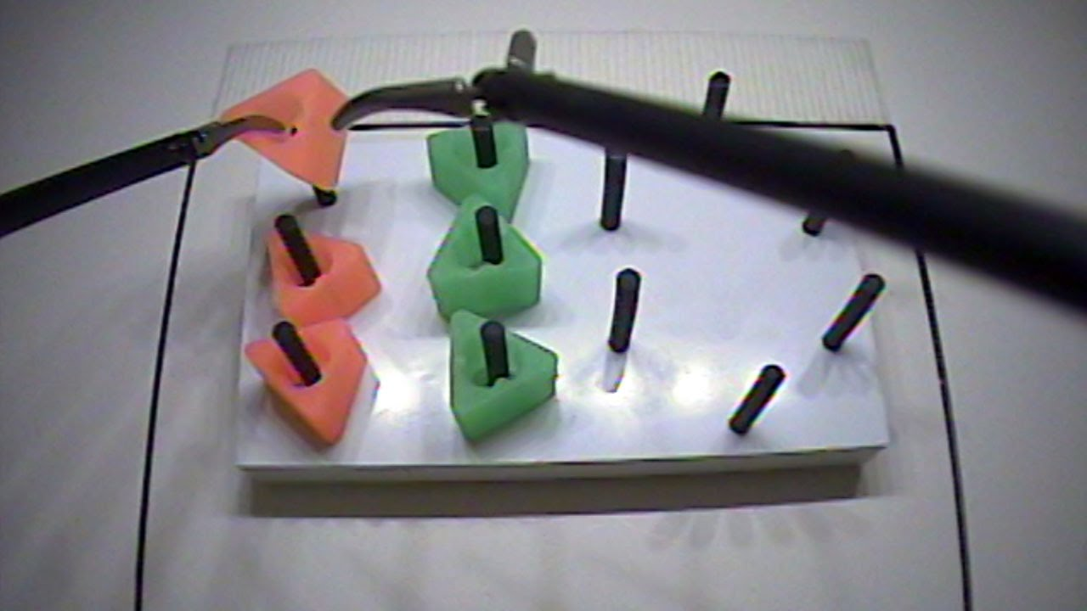
Need help?
Timer: 00:00
START
STOP

Slide 5
• recording
Need help?
Timer: 00:01
STOP

Slide 6
• recording
Need help?
Timer: 00:02
STOP

Slide 7
• recording
Need help?
Timer: 00:03
STOP

Slide 8
Task Result: Peg Transfer
Time Elapsed: 01:43
Did you drop a peg outside field of view?
Did your instrument leave the field of view?
YES NO
YES NO
Programming note: task considered failure if either question is answered yes or time exceeds 48 seconds
Grade My Performance

Slide 9
Task Result: Peg Transfer
Time Elapsed: 01:43
Result: FAIL
Save Video?

Slide 10
Task Result: Peg Transfer
Time Elapsed: 01:43
Result: FAIL
Video Saved! Return home?

Slide 11
Task 2: Pattern Cut
Task Instructions:
Timing begins when gauze is touched. Timing ends when marked circle is completely cut from gauze.
Provide traction to gauze using Maryland dissector in either hand
Use scissors in other hand to cut into the gauze and in between training circles drawn on gauze until it is completely removed.
Only top layer needs to be cut. Bottom layers of multi-ply gauze can be cut as much or as little as desired.
Gauze cannot be reaffixed to clip if pulled out during task.
Penalties:
Maximum time: 300 secs
Time limit for proficiency: 98 secs
Cutting into or outside training lines drawn on gauze
Begin Task

Slide 12
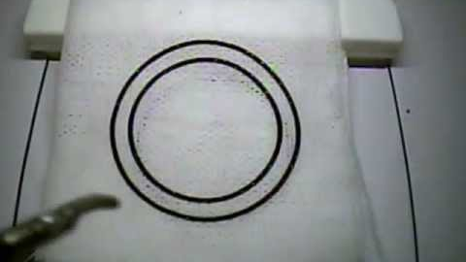
Need help?
Timer: 00:00
START
STOP

Slide 13
• recording
Need help?
Timer: 00:01
STOP

Slide 14
• recording
Need help?
Timer: 00:02
STOP

Slide 15
• recording
Need help?
Timer: 00:03
STOP

Slide 16
Task Result: Pattern Cut
Time Elapsed: 01:30
Did you cut outside the training lines?
YES NO
Programming note: task considered failure if question is answered yes or time exceeds 98 seconds
Grade My Performance

Slide 17
Task Result: Pattern Cut
Time Elapsed: 01:30
Result: PASS
Save Video?

Slide 18
Task Result: Pattern Cut
Time Elapsed: 01:30
Result: PASS
Video Saved! Return home?

Slide 19
Task 3: Ligating Loop
Task Instructions:
Timing when instrument or loop is visible. Timing ends when end of loop material is cut.
Using the grasper or Maryland dissector in one hand and the pre-tied ligating loop in the other, position the loop around the marked target on the appendage of the foam organ.
Break off the end of the plastic pusher at the mark and secure the knot by sliding the pusher rod down, within 1 mm of the mark.
Introduce the scissors and cut the end of the loop material. For practicing, you may simulate cutting the loop to save resources.
Penalties:
Maximum time: 180 secs
Time limit for proficiency: 53 secs
Loop not secured fully around the appendage
Loop > 1 mm away from mark on appendage
Begin Task

Slide 20
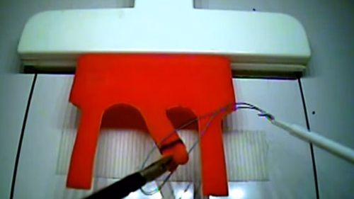
Need help?
Timer: 00:00
START
STOP

Slide 21
• recording
Need help?
Timer: 00:01
STOP

Slide 22
• recording
Need help?
Timer: 00:02
STOP

Slide 23
• recording
Need help?
Timer: 00:03
STOP

Slide 24
Task Result: Ligating Loop
Time Elapsed: 01:05
Is the loop securely on the appendage?
Is the loop < 1 mm away from the mark on the appendage?
Programming note: task considered failure if any are true: first question is no, second question is yes OR time > 53 seconds
YES NO
YES NO
Grade My Performance

Slide 25
Task Result: Ligating Loop
Time Elapsed: 01:05
Result: FAIL
Save Video?

Slide 26
Task Result: Ligating Loop
Time Elapsed: 01:05
Result: FAIL
Video Saved! Return home?

Slide 27
Task 4: Extracorporeal Suture
Task Instructions:
Timing of this task begins when first instrument is visible. Timing ends when you have cut both ends of the suture.
Use a needle driver to grasp the thread and introduce the suture into the device.
Using two needle drivers, place a long suture through the two marks on the penrose drain, within 1 mm of the marks
Tie 3 single throws of a knot extracorporeally using a knot pusher to secure each throw, closing the slit.
Exchange one tool with scissors and cut both ends of the suture.
Penalties:
Maximum time: 420 secs
Time limit for proficiency: 136 secs
Knot is not fully secure
Slit in drain is not closed
Suture is > 1 mm away from marks
Drain is pulled off foam block
Begin Task

Slide 28
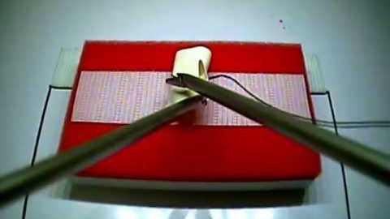
Need help?
Timer: 00:00
START
STOP

Slide 29
• recording
Need help?
Timer: 00:01
STOP

Slide 30
• recording
Need help?
Timer: 00:02
STOP

Slide 31
• recording
Need help?
Timer: 00:03
STOP

Slide 32
Task Result: Extracorporeal Suture
Time Elapsed: 01:59
Is the knot secure?
Is the slit closed?
Is the suture < 1 mm away from the dots on the drain?
Did you pull the drain off the foam block?
YES NO
YES NO
YES NO
YES NO
Programming note: task considered failure if any are true: first two questions (secure and closed) are no, last two questions (1 mm and pulling) are yes OR time > 136 seconds
Grade My Performance

Slide 33
Task Result: Extracorporeal Suture
Time Elapsed: 01:05
Result: FAIL
Save Video?

Slide 34
Task Result: Extracorporeal Suture
Time Elapsed: 01:05
Result: FAIL
Video Saved! Return home?

Slide 35
Task 5: Intracorporeal Suture
Task Instructions:
Timing of this task begins when first instrument is visible. Timing ends when you have cut both ends of the suture.
Use a needle driver to grasp the thread and introduce the suture into the device.
Using two needle drivers, place a short suture through the two marks on the penrose drain, within 1 mm of the marks
Tie 3 throws of a knot intracorporeally, starting with 1 double throw and then 2 single throws, closing the slit. You must exchange hands with your needle between each throw.
Exchange one tool with scissors and cut both ends of the suture.
Penalties:
Maximum time: 600 secs
Time limit for proficiency: 112 secs
Knot is not fully secure
Slit in drain is not closed
Suture is > 1 mm away from marks
Drain is pulled off foam block
Begin Task

Slide 36
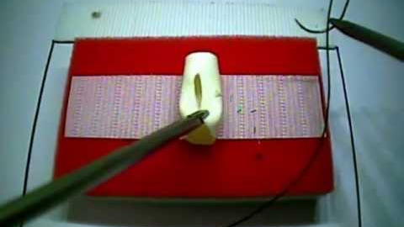
Need help?
Timer: 00:00
START
STOP

Slide 37
• recording
Need help?
Timer: 00:01
STOP

Slide 38
• recording
Need help?
Timer: 00:02
STOP

Slide 39
• recording
Need help?
Timer: 00:03
STOP

Slide 40
Task Result: Intracorporeal Suture
Time Elapsed: 02:15
Is the knot secure?
Is the slit closed?
Is the suture < 1 mm away from the dots on the drain?
Did you pull the drain off the foam block?
Programming note: task considered failure if any are true: first two questions (secure and closed) are no, last two questions (1 mm and pulling) are yes OR time > 112 seconds
Programming note: task considered failure if any are true: first two questions (secure and closed) are no, last two questions (1 mm and pulling) are yes OR time > 112 seconds
YES NO
YES NO
YES NO
YES NO
Grade My Performance

Slide 41
Task Result: Intracorporeal Suture
Time Elapsed: 01:05
Result: PASS
Save Video?

Slide 42
Task Result: Intracorporeal Suture
Time Elapsed: 01:05
Result: PASS
Video Saved! Return home?

